Slide 1
Connected and Autonomous Robotic Systems
Project Advisor: Prof. Kaikai Liu
Team Members: Jay Parsana
Prashant Gandhi
Saumil Shah
Vatsal Makani

Slide 2
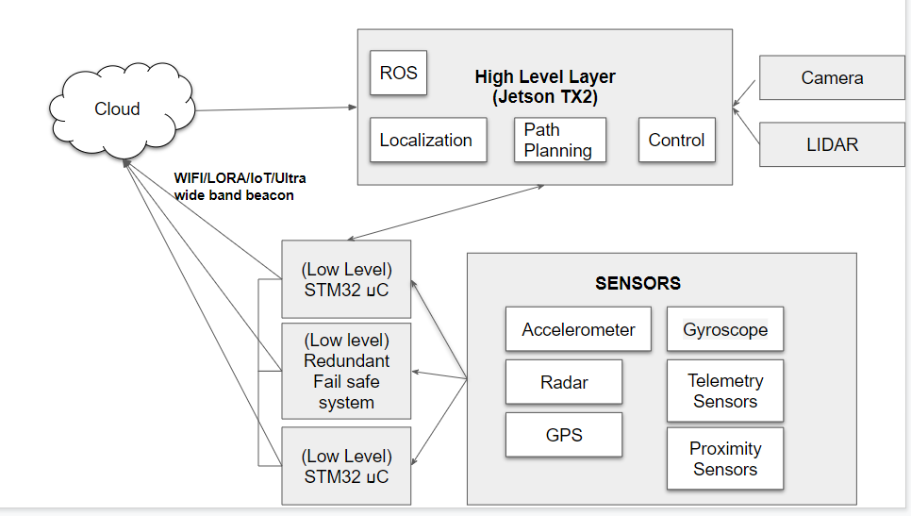
Project Description
Project Basic Building blocks: Embedded systems, IoT and distributed sensor networks. Divided into low level and high level controller architecture
Low level architecture: Multiple STM32 microcontroller interfaced with telemetry and motion sensors
High level architecture: Nvidia Jetson TX2 supporting complex frameworks, autonomous localization and deep learning applications
Added a redundant microcontroller in case of failure of other controllers
Architectures talk via IoT framework/Sigfox/Wifi/LoRa

Slide 3
Project Deliverables
Design, develop and deploy robotic or automotive system for autonomous cars, wheelchairs, industrial robots, etc.
Providing a complete package of hardware and software solutions for autonomous systems
Connected robotic system communicating via IoT framework creating a distributed sensor network
Useful for various applications in medical, robotics, industrial and automotive domain.

Slide 4
Project Dependencies and Concerns
In some scenarios, lidars fail to detect smooth surfaces walls, etc.
Robotic system’s integration with stm32 and Nvidia Jetson Tx2 is challenging
Implementation of localization and path planning requires extensive research
IoT based robotic system vulnerable to data breaches raising privacy concerns

